Slide 1
Mining Binary Constraints in Feature Models: A Preliminary Experiment
2011.4.21
Yi Li

Slide 2
Outline
Introduction
The Approach
The Experiment

Slide 3
Motivation
Domain feature models (DFMs) = Features + Constraints
Reuse DFMs (Application Engineering) = Select a subset of Features satisfying the Constraints
Domains become increasingly complex
DFMs in practice contains more and more features (e.g. thousands)
What makes things worse: finding constraints is often harder than finding features

Slide 4
Why Finding Constraints is Challenging
My experience (in DFMs of 100 features)
Needs of abstraction: Unlike features, most constraints can’t be directly observed from existing products
Time-consuming: I have to browse the whole DFM several times
Tend to miss: I have to look at one feature, and try to remember the features I saw before, and suddenly think of a constraint between them
No full vision: I can only see a small part of DFM due to the limitation of displaying area or printing area, but constraints can spread over the whole DFM

Slide 5
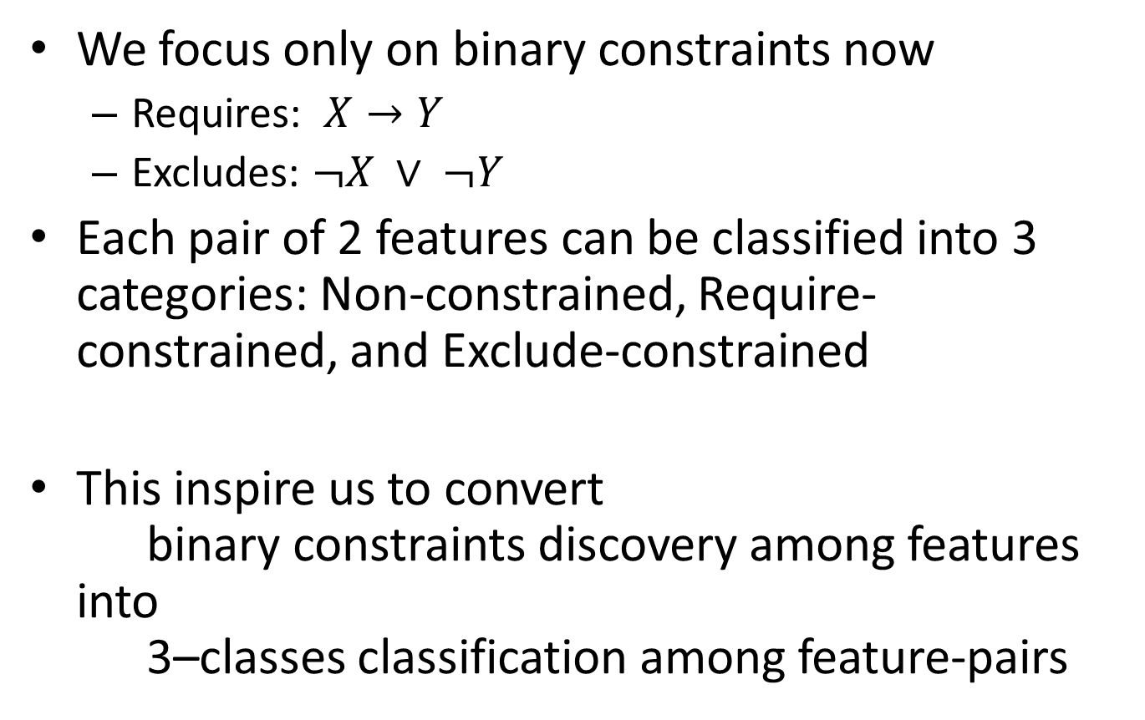
An Automated Way to Constraint Discovery
We focus only on binary constraints now
Requires: $X→Y$
Excludes: $¬X ∨ ¬Y$
Each pair of 2 features can be classified into 3 categories: Non-constrained, Require-constrained, and Exclude-constrained
This inspire us to convert binary constraints discovery among features into 3–classes classification among feature-pairs

Slide 6
Approach Overview
Non-Constrained
3. Optimize
1. Pairing
Requires
Classifier
Input: DFM
2. Train
Excludes
Unknown
4. Classify
Feature Pairs

Slide 7
Outline
Overview
Step 1: Preparing Data
Pairing
Describe the pairs
Step 2: Classification
Step 3: Cross Validation & Optimization
The Experiment

Slide 8
Pairing
Unordered Pairing
If (A, B) is a “requires-pair”, then A requires B or B requires A or both.
Why unordered?
Because “non-constrained” and “excludes” are unordered, if we use ordered pairing “<A, B>”, then there are redundant pairs (data) for “non-constrained” and “excludes” classes.
An advantage brought by pairing is that the size of dataset is large even for a small set of features.
n features → n(n-1)/2 unordered pairs
Big dataset is good for machine learning

Slide 9
Describe the Pairs
Before classification, we must represent each pair as a group of numeric attributes.
Attribute 1: Description Similarity of the paired features (0.0 to 1.0)
Reason: In many cases, totally dissimilar features ➔ not-constrained.
Examples from Media Player DFM Media Library: library for music, videos and podcasts. Run on iOS: This player can run on the Apple iOS system. (Not-Constrained)

Slide 10
Describe the Pairs
Attribute 2: Is Refinement? ( -1=NO, 1=YES, 0=Unknown)
Does the paired features form a refinement?
Reason: Typically, X refines Y ➔ No other (explicit) constraints between X and Y are needed.
Attribute 3: Is Sibling? (-1, 1, or 0)
Reason: In most cases, X & Y are siblings ➔ No other explicit constraints between them.

Slide 11
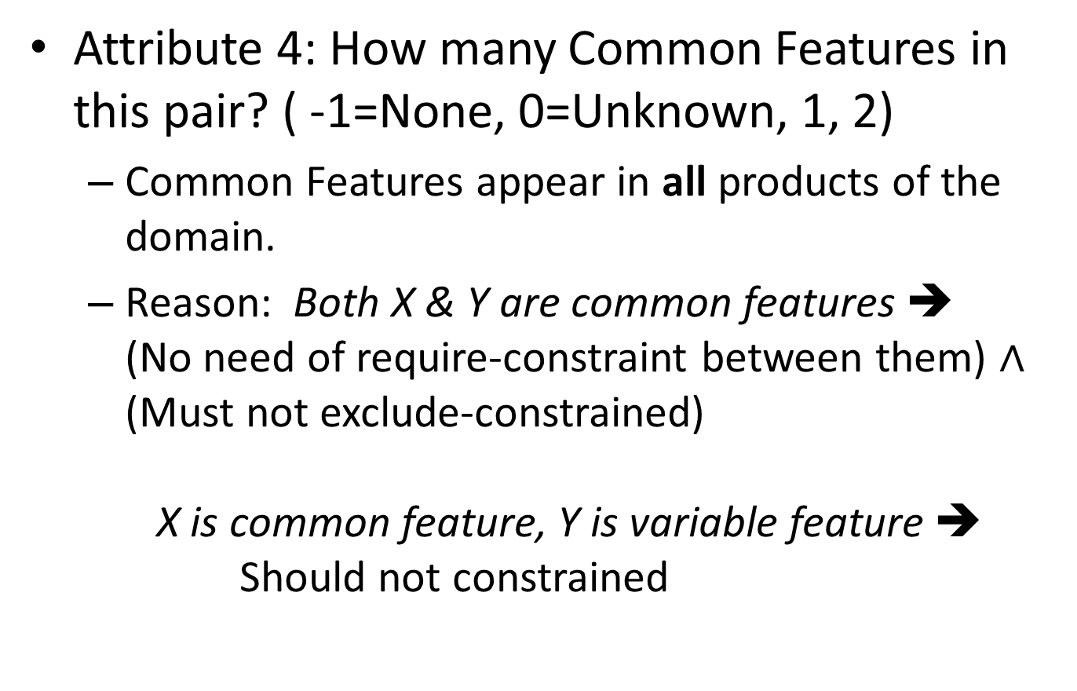
Describe the Pairs
Attribute 4: How many Common Features in this pair? ( -1=None, 0=Unknown, 1, 2)
Common Features appear in all products of the domain.
Reason: Both X & Y are common features ➔ (No need of require-constraint between them) $∧$ (Must not exclude-constrained) X is common feature, Y is variable feature ➔ Should not constrained

Slide 12
Describe the Pairs
Attribute 5/6: Does one of the paired feature have require/exclude-relation with another feature outside the pair?
Reason: Many features involve in more than one constraint.
Several features require a core (infrastructure) feature.
A feature excludes a set of co-related features.
Examples from Media Player DFM Run on Mobile Phone excludes {Audio CD Support, External Device Connection, … }
requires

Slide 13
Outline
Overview
Step 1: Preparing Data
Step 2: Classification
A brief introduction to Support Vector Machine
LIBSVM: A practical SVM classifier
Step 3: Cross Validation & Optimization
The Experiment

Slide 14
Support Vector Machine
A classification technique that has shown promising empirical results in many practical applications.
Basic Idea
A feature pair = A point in k-dimensional space (k is the number of attributes)
Classification = Find a hyperplane (a line in 2-D space) to separate these points

Slide 15
Find the Line in 2D
Attribute 1
Attribute 2
There are infinite number of lines available.

Slide 16
SVM: Find the Best Line
Best = Maximum Margin
Margin for Red
Larger margin has fewer prediction errors.
Attribute 1
Margin for Green
Attribute 2
These points defining the margin are called “support vectors”.

Slide 17
Soft Margin in Practical SVM
Trade-off between width of margin and number of training errors
Red should still be preferred over Green. (The new training examples may correspond to noise.)
Attribute 1
Attribute 2

Slide 18
Non-linear SVM
Attribute 1
Classification Boundary
Attribute 2
The classification boundary is not a line.

Slide 19
Transform Non-linear to Linear
Map the points into a new space. (The mapping function is called the Kernel Function.)
In practice, the new space often has much higher dimension than the origin space.
(Attribute 1)² – Attribute 1
(Attribute1, Attribute2) →
(Attribute1² – Attribute1 , Attribute2² – Attribute2)
(Attribute 2)² – Attribute 2

Slide 20
Issue in Classification(1): Multi-class
The SVM introduced before can handle only 2 class (binary classification). How to handle more classes?
A widely used approach is to perform binary classification against each class:
1. Non-Constrained vs. Others
2. Requires vs. Others
3. Excludes vs. Others
It produces a 0-1 string (Y₁, Y₂, Y₃) for each data item, where Y_{i} = 0, the item is “Others” in i^{th} classification; Y_{i} = 1, else.

Slide 21
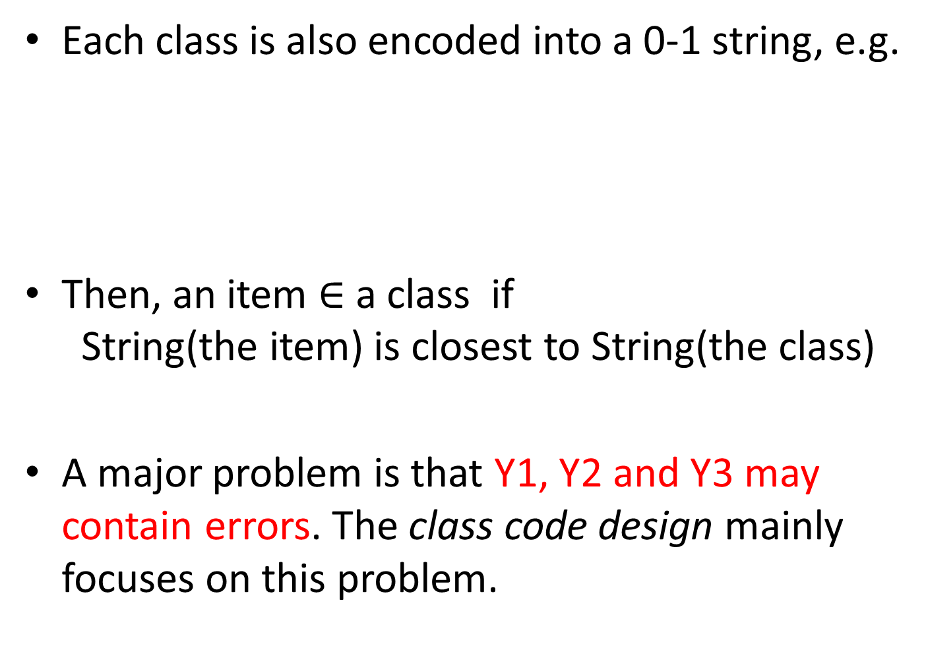
Each class is also encoded into a 0-1 string, e.g.
Then, an item $∈$ a class if String(the item) is closest to String(the class)
A major problem is that Y1, Y2 and Y3 may contain errors. The class code design mainly focuses on this problem.
 | Y1 | Y2 | Y3
Non-Constrained | 1 | 0 | 0
Requires | 0 | 1 | 0
Excludes | 0 | 0 | 1
 | Y1 | Y2 | Y3
Non-Constrained | 1 | 1 | 0
Requires | 0 | 1 | 1
Excludes | 1 | 0 | 1
or

Slide 22
Issue (2): Data Scaling
Different attributes may have different value ranges, e.g.
Similarity: 0.2 vs. 0.9 = significant, but small distance (0.9 – 0.2 = 0.7) in space.
Common Features: -1 vs. 0 = insignificant, but big distance (0 – -1 = 1) in space.
To handle such problems, all values are scaled to the range [-1, 1] or [0, 1]

Slide 23
Issue (3): Unbalanced Classes
There are far more “non-constrained” pairs than “requires” and “excludes” pairs in DFMs.
Such unbalanced classes can lead to biased accuracy:
50 exclude-pairs, 950 non-constrained-pairs
A cheat classifier: classify everything as “non-constrained”
Accuracy = 95%
Weighted classes are introduced to handle such problem.
For example, missing an “exclude” is weighted 10 times worse than missing a “non-constrained” pair.
In SVM, the weight actually influence the number of training errors in the soft margin trade-offs. High class weight ➔ Few training errors for this class

Slide 24
LIBSVM: A practical SVM classifier
Chih-Chung Chang and Chih-Jen Lin, National Taiwan University
See http://www.csie.ntu.edu.tw/~cjlin/libsvm/
Key features of LIBSVM
Easy-to-use interfaces (svm_scale, svm_train, svm_predict)
Integrated support for cross-validation (discuss later)
Support for multi-class, data scaling and unbalanced classes
Source code available in about 20 languages

Slide 25
Use LIBSVM in Real World
1. Format the data as required by LIBSVM.
2. Scale training set and test set with the same scaling factor. (LIBSVM.svm_scale)
3. Train with cross-validation to find the best parameters of the data, the kernel function and the class weights. (LIBSVM.svm_train)
4. Test. (LIBSVM.svm_predict)

Slide 26
Outline
Overview
Preparing Data
Classification
Step 3: Cross Validation & Optimization
Cross Validation
Optimization with Genetic Algorithms
The Experiment

Slide 27
Cross-Validation
An approach to evaluating the classifier with training set only.
Therefore the classifier can be evaluated (and optimized) before applying on real test sets.
Non-Constrained
k-Fold Cross-Validation
Divide the training set into k equal-sized subsets.
Run the classifier k times.
During each run, one subset is chosen for testing, and others for training.
We focus on validating the accuracy of classification
Requires
Only the Training Set is Used
Excludes
Unknown
(Real) Test Set
Feature Pairs

Slide 28
Optimize the Classifier
Basic concepts of optimization
Solution: a set of parameters to be optimized
Cost Function: a function that evaluates higher values for worse solutions.
Optimization tries to find a solution with lowest cost.
For the classifier
Solution = [gamma (a kernel parameter), W-require, W-excludes]
Each parameter has a valid range.
Cost (Solution) = 1 – Accuracy of the solution

Slide 29
Genetic Algorithm
Basic idea
Start with random solutions (initial population)
Produce next generation from top elites of current population
Mutation: slightly change an elite solution
Crossover (Breeding): combine random parts of 2 elite solutions into a new one
Repeat until the stop condition has been reached (e.g. max number of generation)
The best solution of last generation is the overall best solution.
[ 0.3, 2, 5 ] ➔ [ 0.4, 2, 5 ]
[ 0.3, 2, 5 ] and [ 0.5, 3, 3 ] ➔ [ 0.3, 3, 3 ]

Slide 30
Outline
Overview
Preparing Data
Classification
Cross Validation & Optimization
The Experiment

Slide 31
Experiment Settings
Process
Data
Domain feature model of “Media Player”
58 features collected from Wikipedia and online documents (1653 pairs, 59 requires, 62 excludes)
The DFM is used as both training set and test set
The test set is a copy of the DFM while leaves out all the existing constraints.
Test DFM
Correct New Constraints
Training DFM
CV & Optimization
Prediction
Feedback
Correct New Constraints
LEGEND
Automated
Manual

Slide 32
CV & Optimization
Optimization with Genetic Algorithms
Cross-Validation Fold = 4
Population Size = 25
Max Generation = 80
Top Elites Proportion = 20%
Crossover Probability = 80% (Mutation = 20%)
CV Accuracy (10 passes)

Slide 33
Prediction
In each pass, 20 newly discovered constraints in the test set are randomly chosen from all discoveries, and displayed for feedback
Decreased when there’s no many constraints left in test set.

Slide 34
Some Observations
Does treating refinements as constraints improve the results? (Motivation is to increase the size of constraint-pair set.)
NO.
It leads to a lots of false positives (false constraints).
Setting the weights: too low ➔ false negatives (Discover few constraints) too high ➔ false positives Weights of requires and excludes are close ➔ low accuracy
A
(B requires A) and (C requires A) and (D requires A) and
(B excludes C) and
(B excludes D) and
(C excludes D)
XOR
B
C
D

Slide 35
Outline
Overview
Preparing Data
Classification
Cross Validation & Optimization
The Experiment
What’s Next

Slide 36
Future Work
Apply the classifier on different test DFMs.
Refine the training and test DFMs so they become more real
E.g. describe a feature via synthesizing its descriptions from several products
More experiments and measures (see how data mining researchers do this)
Find more attributes / Adjust attributes
E.g.: Improve the computation of “similarity”

Slide 37
Thank you for listening! Q&A

